Slide 1

CSE413 – Security of Information Systems 2020 PhD Furkan Gözükara, Toros University https://github.com/FurkanGozukara/Security-of-Information-Systems-CSE413-2020
Lecture 3
Cryptography
Composed from Prof. Audun Jøsang, University of Oslo, Information Security 2018 Lectures
Source : https://www.uio.no/studier/emner/matnat/ifi/INF3510/v18/lectures/

Slide 2
Outline
What is cryptography?
Brief crypto history.
Security issues.
Symmetric cryptography:
Stream ciphers.
Block ciphers.
Hash functions.
Asymmetric cryptography:
Factoring based mechanisms.
Discrete Logarithms.
Digital signatures.
Quantum Resistant Crypto.
Want to learn more?
Look up UNIK 4220
2

Slide 3


The security pyramid
User
Secure
systems
Communication- protocols
Cryptographic mechanisms
Mathematics
Electronics
Statistics
Informatics
Quantum physics
Ethics
Politics

Slide 4

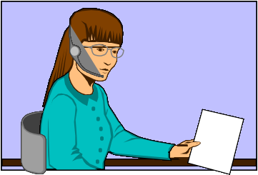
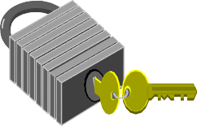

What is cryptology?
Alice
Bob
Secure communication over unsecure channels
Confidentiality
Integrity
Authenticity
Non-repudiation
Symmetric crypto
Asymmetric crypto
Oscar

Slide 5
Terminology
Cryptology
Cryptography
Cryptanalysis
Cryptography is the science of secret writing with the goal of hiding the meaning of a message.
Cryptanalysis is the science and sometimes art of breaking cryptosystems.

Slide 6
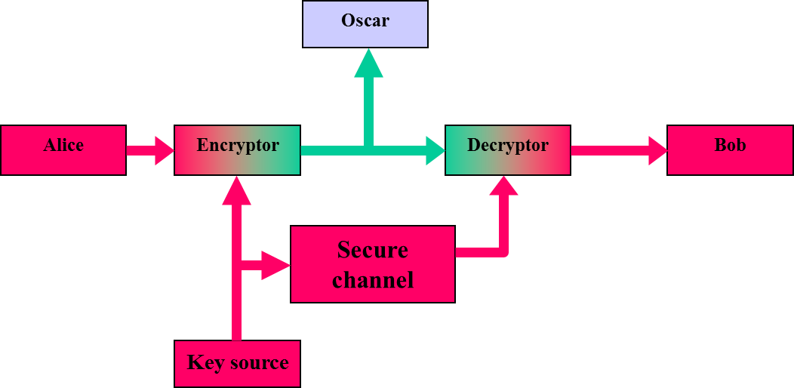
Model of symmetric cryptosystem

Slide 7
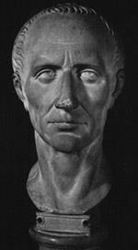
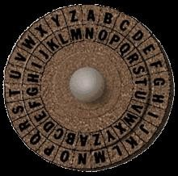
Caesar cipher
Example: Caesar cipher
P = {abcdefghijklmnopqrstuvwxyz}
C = {DEFGHIJKLMNOPQRSTUVWXYZABC}
Plaintext:
kryptologi er et spennende fag
Chiphertext: NUBSWRORJL HU HT VSHQQHQGH IDJ
Note: Caesar chipher in this form does not include a variable key, but is an instance of a “shift-cipher” using key K = 3.

Slide 8
Numerical encoding of the alphabet
a | b | c | d | e | f | g | h | i | j | k | l | m | n | o
0 | 1 | 2 | 3 | 4 | 5 | 6 | 7 | 8 | 9 | 10 | 11 | 12 | 13 | 14
p | q | r | s | t | u | v | w | x | y | z | æ | ø | å
14 | 16 | 17 | 18 | 19 | 20 | 21 | 22 | 23 | 24 | 25 | 26 | 27 | 28
Using this encoding many classical crypto systems can be expressed as algebraic functions over Z₂₆ (English alphabet) or Z₂₉ (Norwegian alphabet)

Slide 9
Shift cipher
Let P = C = Z_{26.} For 0 ≤ K ≤ 25, we define E(x, K) = x + K (mod 26)
and
D(y, K) = y - K (mod 26)
(x, y ∈ Z ₂₆)
Question: What is the size of the key space? Puzzle: ct =
LAHYCXPAJYQHRBWNNMNMOXABNLDANLXVVDWRLJCRXWB
Find the plaintext!

Slide 10
Exhaustive search
For[i=0, i<26, i++, Print["Key = ", i, " Plain = ", decrypt[ct,1,i]]]
Key = 0 Plain = LAHYCXPAJYQHRBWNNMNMOXABNLDANLXVVDWRLJCRXWB
Key = 1 Plain = KZGXBWOZIXPGQAVMMLMLNWZAMKCZMKWUUCVQKIBQWVA
Key = 2 Plain = JYFWAVNYHWOFPZULLKLKMVYZLJBYLJVTTBUPJHAPVUZ
Key = 3 Plain = IXEVZUMXGVNEOYTKKJKJLUXYKIAXKIUSSATOIGZOUTY
Key = 4 Plain = HWDUYTLWFUMDNXSJJIJIKTWXJHZWJHTRRZSNHFYNTSX
Key = 5 Plain = GVCTXSKVETLCMWRIIHIHJSVWIGYVIGSQQYRMGEXMSRW
Key = 6 Plain = FUBSWRJUDSKBLVQHHGHGIRUVHFXUHFRPPXQLFDWLRQV
Key = 7 Plain = ETARVQITCRJAKUPGGFGFHQTUGEWTGEQOOWPKECVKQPU
Key = 8 Plain = DSZQUPHSBQIZJTOFFEFEGPSTFDVSFDPNNVOJDBUJPOT
Key = 9 Plain = CRYPTOGRAPHYISNEEDEDFORSECURECOMMUNICATIONS
Key = 10 Plain = BQXOSNFQZOGXHRMDDCDCENQRDBTQDBNLLTMHBZSHNMR
Key = 11 Plain = APWNRMEPYNFWGQLCCBCBDMPQCASPCAMKKSLGAYRGMLQ
Key = 12 Plain = ZOVMQLDOXMEVFPKBBABACLOPBZROBZLJJRKFZXQFLKP
.
•

Slide 11

Substitution cipher - example
a | b | c | d | e | f | g | h | i | j | k | l | m | n | o
U | D | M | I | P | Y | Æ | K | O | X | S | N | Å | F | A
p | q | r | s | t | u | v | w | x | y | z | æ | ø | å
E | R | T | Z | B | Ø | C | Q | G | W | H | L | V | J
Plaintext: fermatssisteteorem Ciphertext: YPTÅUBZZOZBPBPATPÅ
What is the size of the key space?
8841761993739701954543616000000
₂103

Slide 12
Lessons learned
A cipher with a small keyspace can easily be attacked by exhaustive search.
A large keyspace is necessary for a secure cipher, but it is by itself not sufficient.
Monoalphabetical substitution ciphers can easily be broken.

Slide 13
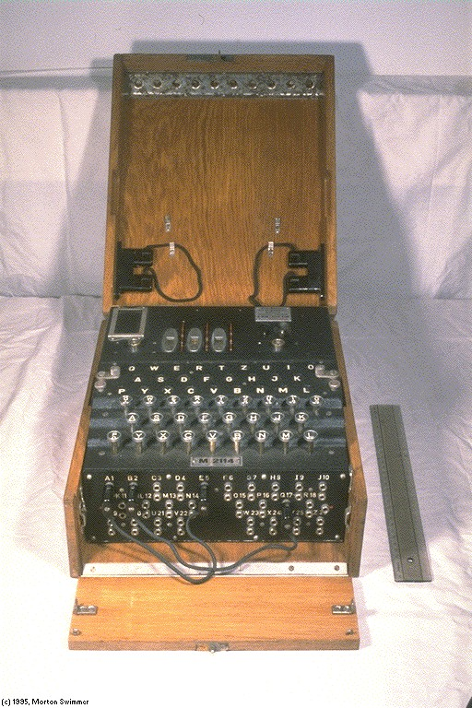
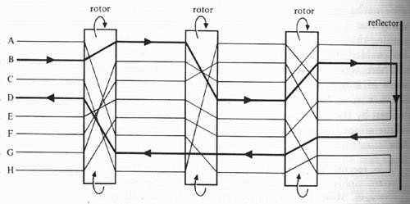
Enigma
German WW II crypto machine.
Many different variants.
Polyalphabetical substitution.
Analysed by Polish and English mathematicians.

Slide 14
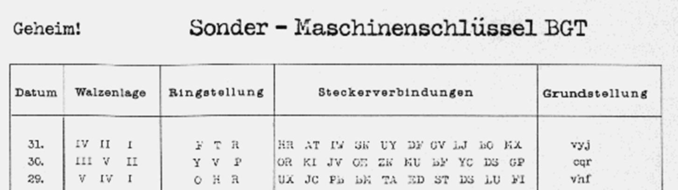
Enigma key list

Slide 15
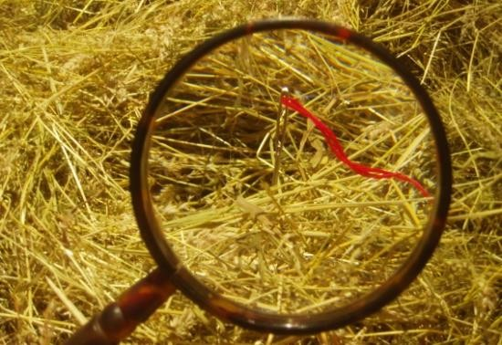
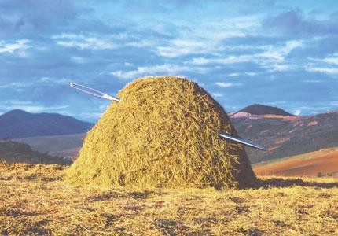
Practical complexity for attacking Enigma
Cryptoanalytical assumptions during WW II:
3 out of 5 rotors with known wiring.
10 stecker couplings.
Known reflector.
N = 150 738 274 937 250 · 60 · 17 576 · 676 =
107458687327250619360000 (77 bits)

Slide 16
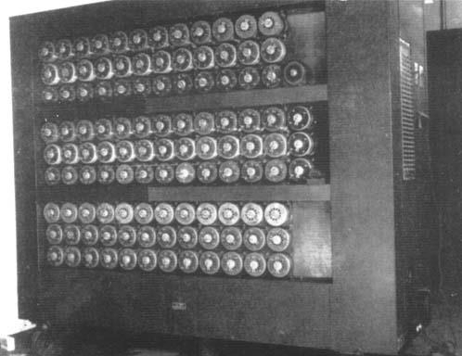
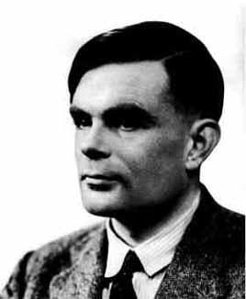
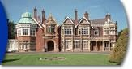
Attacking ENIGMA
Posisjon: | 1 | 2 | 3 | 4 | 5 | 6 | 7
Chiffertekst: | J | T | G | E | F | P | G
Crib: | R | O | M | M | E | L | F
R _{M} R ₄
T G
Z
3
A
E
A
7
5
_{G} F
G

Slide 17
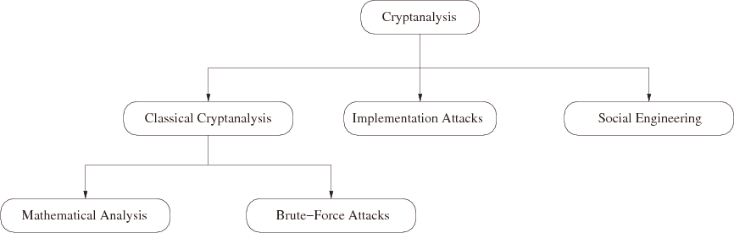
Cryptanalysis: Attacking Cryptosystems
Classical Attacks:
Mathematical Analysis.
Brute-Force Attack.
Implementation Attack: Try to extract the key through reverse engineering or power measurement, e.g., for a banking smart card.
Social Engineering: E.g., trick a user into giving up her password

Slide 18
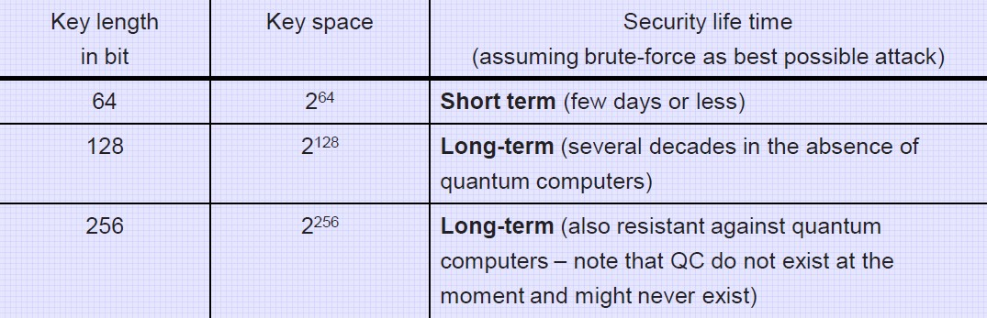
Brute-Force Attack (or Exhaustive Key Search)
Treats the cipher as a black box.
Requires (at least) 1 plaintext-ciphertext pair (x₀, y₀).
Check all possible keys until condition is fulfilled:
d_{K}(y₀) = x₀
How many keys to we need ?

Slide 19
Attack models:
Known ciphertext.
Known plaintext.
Chosen plaintext (adaptive) .
Chosen ciphertext (adaptive).
What are the goals of the attacker?
Find the secret plaintext or part of the plaintext.
Find the encryption key.
Distinguish the encryption of two different plaintexts.
How clever is the attacker?

Slide 20
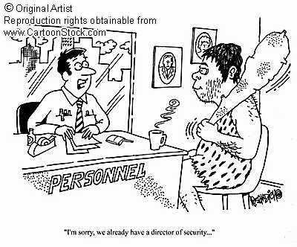
Does secure ciphers exist?
What is a secure cipher?
Perfect security.
Computational security.
Provable security.

Slide 21
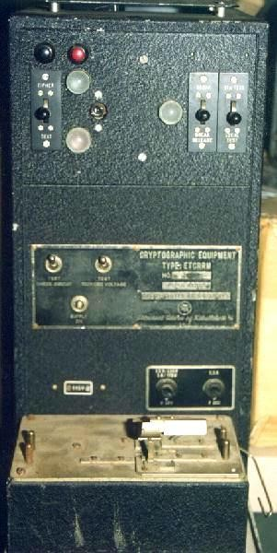
ETCRRM
Electronic Teleprinter Cryptographic Regenerative Repeater Mixer (ETCRRM).
Invented by the Norwegian Army Signal Corps in 1950.
Bjørn Rørholt, Kåre Mesingseth.
Produced by STK.
Used for ”Hot-line” between Moskva and Washington.
About 2000 devices produced.

Slide 22
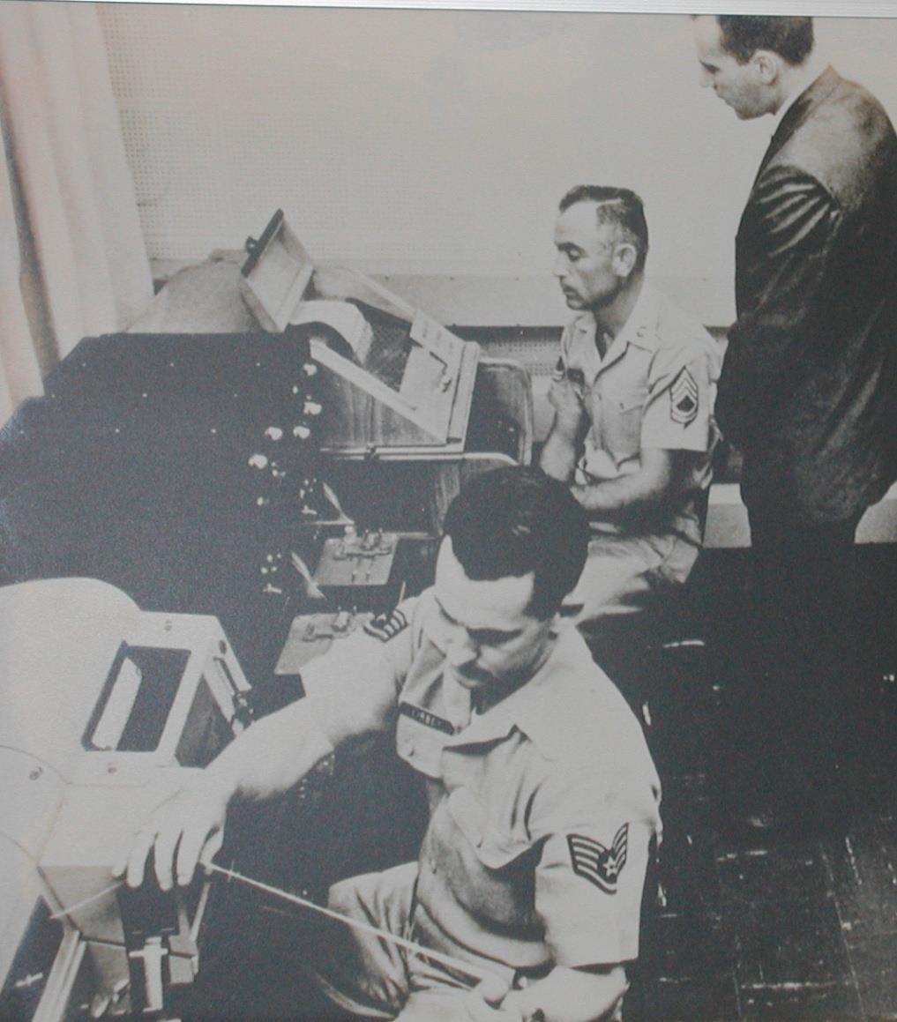
White House Crypto Room 1960s

Slide 23
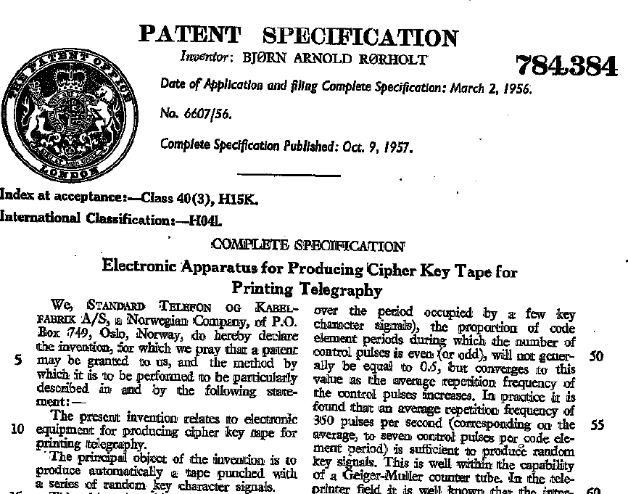
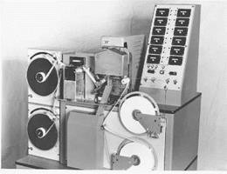
Producing key tape for the one-time pad

Slide 24
Symmetric encryption
Is it possible to design secure and practical crypto?

Slide 25
Stream Cipher vs. Block Cipher
Plaintext blocks
Key
n bits
Key stream generator
MI
Block Cipher
Key
Key stream
⊕
n bits
Ciphertext stream Plaintext stream
Stream cipher
Ciphertext blocks
Block cipher

Slide 26
Symmetric stream cipher
Key MI
Key MI
Pseudorandom-
generator
Pseudorandom- generator
Κεψ στρεαμ
Κεψ στρεαμ
⊕
⊕

Slide 27
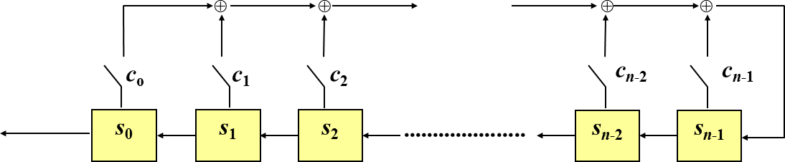
LFSR
Linear feedback shift register
Output
Υσινγ n φλιπ−φλοπσ ωε μαψ γενερατε α βιναρψ σεθυενχε οφ περιοδ 2 ^{n} −1
^{𝑠}𝑛+𝑖 ^{= 𝑐}0 ^{𝑠}𝑖 ^{+ 𝑐}1 ^{𝑠}𝑖+1 ^{+ ⋯ + 𝑐}𝑛−1 ^{𝑠}𝑖+𝑛−1
Note: The stream cipher is stateful

Slide 28


Symmetric block cipher
Plaintext
The algorithm represents a family of permutations of the message space
Normally designed by iterating a less secure round function
May be applied in different operational modes
Must be impossible to derive K based on knowledge of P and C
 |  |  | P_{i}
Crypto- algorithm
K
 |  |  | C_{i}
Ciphertext

Slide 29
Itrerated block cipher design
x
K
Algorithm:
w⁰ ← x
w¹ ← g(w⁰,K¹) w² ← g(w¹,K²)
•
•
_{w}Nr-1 _{← g(w}Nr-2_{,K}Nr-1₎
_{w}Nr _{← g(w}Nr-1_{,K}Nr₎
y ← w^{Nr}
NB! For a fixed K, g must be injective in order to decrypt y
_{w}0
g(w⁰,K¹)
_{K}1
_{w}1
g(w¹,K²)
_{K}2
•
•
_{g(w}Nr-1_{,K}Nr₎
_{K}Nr
_{w}Nr

Slide 30
Substitution-Permutation network (SPN):
Round function g :
State
_{w}i-1
S-boxes
_{S}1
_{S}2
_{S}3
_{S}4
_{S}5
Confusion
Permutation
Diffusion
Key mix
_{K}i
⊕
New state
_{w}i

Slide 31
Data Encryption Standard
Published in 1977 by the US National Bureau of Standards for use in unclassified government applications with a 15 year life time.
16 round Feistel cipher with 64-bit data blocks, 56-bit keys.
56-bit keys were controversial in 1977; today, exhaustive search on 56-bit keys is very feasible.
Controversial because of classified design criteria, however no loop hole was ever found.

Slide 32






DES architecture
P (64 bits)
DES(P):
(L₀, R₀) = IP(P) FOR i = 1 TO 16
^{L}i ^{= R}i-1
R_{i} = L_{i-1} ⊕ f(R_{i-1},K_{i})
C = IP⁻¹(R₁₆,L₁₆)
IP
L₀
R₀
⊕
f
K₁
L₁
R₁
⊕
f
K₂
^{L}15
^{R}15
⊕
f
^{K}16
64 bit data block
56 bit key
72.057.594.037.927.936
^{R}16
^{L}16
_{IP}-1
C (64 bits)

Slide 33
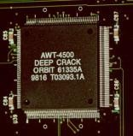

EFF DES-cracker
Dedicated ASIC with 24 DES search engines.
27 PCBs housing 1800 circuits.
Can test 92 billion keys per second.
Cost 250 000 $.
DES key found July 1998 after 56 hours search.
Combined effort DES Cracker and 100.000 PCs could test 245 billion keys per second and found key after 22 hours.

Slide 34
DES Status
DES is the “work horse” which over 30 years have inspired cryptographic research and development
“Outdated by now”!
Single DES can not be considered as a secure block cipher
Use 3DES (ANSI
9.52) or DESX
K₁
K₂
K₃
P
E
E/D
E
C
3DES
K₁ K
K₂
⊕
E
⊕
DESX

Slide 35
Advanced Encryption Standard
Public competition to replace DES: because 56- bit keys and 64-bit data blocks no longer adequate.
Rijndael nominated as the new Advanced Encryption Standard (AES) in 2001 [FIPS-197].
Rijndael (pronounce as “Rhine-doll”) designed by Vincent Rijmen and Joan Daemen.
128-bit block size (Note error in Harris p. 809).
128-bit, 196-bit, and 256-bit key sizes.
Rijndael is not a Feistel cipher.

Slide 36
Rijndael round function
a₀ | a₄ | a₈ | ª12
a₁ | a₅ | a₉ | ª13
a₂ | a₆ | ª10 | ª14
a₃ | a₇ | ª11 | ª15
Initial state
S-box
a₀ | a₄ | a₈ | ª12
a₁ | a₅ | a₉ | ª13
a₂ | a₆ | ª10 | ª14
a₃ | a₇ | ª11 | ª15
Row-shift
a₀ | a₄ | a₈ | ª12
a₅ | a₉ | ª13 | a₁
ª10 | ª14 | a₂ | a₆
a₇ | ª11 | ª15 | a₃
a₀ | a₄ | a₈ | ª12
a₁ | a₅ | a₉ | ª13
a₂ | a₆ | ª10 | ª14
a₃ | a₇ | ª11 | ª15
Key-mix
Coloumn-mix
a₀ | a₄ | a₈ | ª12
a₅ | a₉ | ª13 | a₁
ª10 | ª14 | a₂ | a₆
a₇ | ª11 | ª15 | a₃
⊕
a₀ | a₄ | a₈ | ª12
a₁ | a₅ | a₉ | ª13
a₂ | a₆ | ª10 | ª14
a₃ | a₇ | ª11 | ª15
End state

Slide 37
Rijndael encryption
Key mix (round key K₀)
N_{r}-1 rounds containing:
Byte substitution
Row shift
Coloumn mix
Key mix (round key K_{i})
Last round containing:
Byte substitution
Row shift
Key mix (round key K_{Nr})
Key | Rounds
128 | 10
192 | 12
256 | 14

Slide 38
Block Ciphers: Modes of Operation
Block ciphers can be used in different modes in order to provide different security services.
Common modes include:
Electronic Code Book (ECB)
Cipher Block Chaining (CBC)
Output Feedback (OFB)
Cipher Feedback (CFB)
Counter Mode (CTR)
Galois Counter Mode (GCM) {Authenticated
encryption}

Slide 39

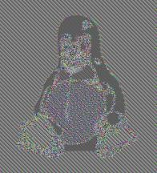

Use a secure mode!
Plaintext
Ciphertext using ECB mode
Ciphertext using secure mode

Slide 40
Integrity Check Functions

Slide 41



Hash functions
Hash function
Hash value

Slide 42
Applications of hash functions
Protection of password.
Comparing files.
Authentication of SW distributions.
Bitcoin.
Generation of Message Authentication Codes (MAC).
Digital signatures.
Pseudo number generation/Mask generation functions.
Key derivation.

Slide 43
Hash functions (message digest functions)
Requirements for a one-way hash function h:
Ease of computation: given x, it is easy to compute h(x).
Compression: h maps inputs x of arbitrary bitlength to outputs h(x) of a fixed bitlength n.
One-way: given a value y, it is computationally infeasible to find an input x so that h(x)=y.
Collision resistance: it is computationally infeasible to find x and x’, where x ≠ x’, with h(x)=h(x’) (note: two variants of this property).

Slide 44
Properties of hash functions
x
?
x
x’
x
?
?
?
h(x)
h(.)
h(x)
h(x)
h(.)
Ease of Pre-image computationresistance
Collision Weak collision
resistance
Strong collision
(2nd pre-image resistance resistance)

Slide 45
Frequently used hash functions
MD5: 128 bit digest. Broken. Often used in Internet protocols but no longer recommended.
SHA-1 (Secure Hash Algorithm):160 bit digest. Potential attacks exist. Designed to operate with the US Digital Signature Standard (DSA);
SHA-256, 384, 512 bit digest. Still secure. Replacement
for SHA-1.
RIPEMD-160: 160 bit digest. Still secure. Hash function frequently used by European cryptographic service providers.
NIST competition for new secure hash algorithm, closed in 2012 with the winner:

Slide 46
A very good read about password hasing
https://www.wordfence.com/learn/how-passwords-work-and-cracking-passwords/

Slide 47
Why MD5 is weaker than higher bits having hashing algorithms?
It is easier to calculate MD5 hash of an input.
Therefore, you can guess more MD5 passwords
Generating collisions is much easier on MD5
https://crypto.stackexchange.com/questions/1434/are-there-two-known-strings-which-have-the-same-md5-hash-value
https://en.wikipedia.org/wiki/Collision_attack

Slide 48
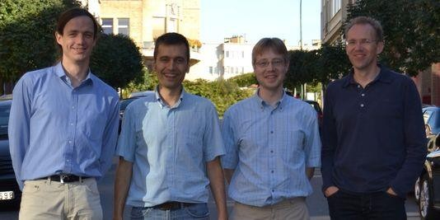
And the winner is?
NIST announced Keccak as the winner of the SHA-3 Cryptographic Hash Algorithm Competition on October 2, 2012, and ended the five- year competition.
Keccak was designed by a team of cryptographers from Belgium and Italy, they are:
Guido Bertoni (Italy) of STMicroelectronics,
Joan Daemen (Belgium) of STMicroelectronics,
Michaël Peeters (Belgium) of NXP Semiconductors, and
Gilles Van Assche (Belgium) of STMicroelectronics.

Slide 49
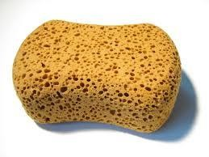
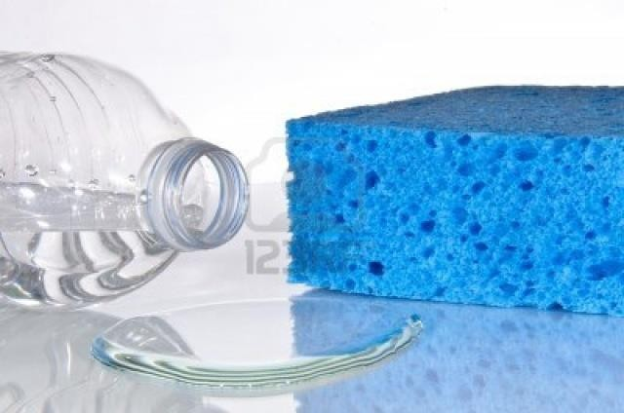
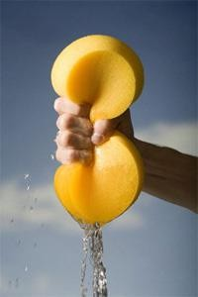
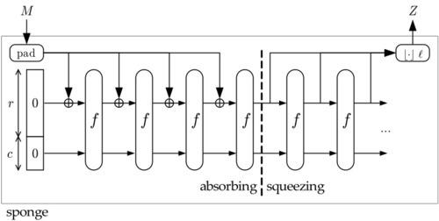
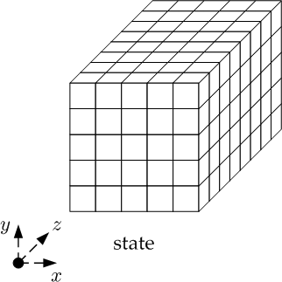
Keccak and sponge functions

Slide 50
End of lecture
50

